Slide 1
▶
intro-to-se · week 01
Applied Digital Technology
Week 1 · Monday 3 August 2026
15031001 · SEMESTER 1 / 2026
MAE FAH LUANG UNIVERSITY · SOFTWARE ENGINEERING
Introduction to Software Engineering
Prasara Jakkaew, Ph.D.
Prasara.jak@mfu.ac.th
Notes:
https://github.com/Sumanth077/Hands-On-AI-Engineering?fbclid=IwY2xjawTNFqNleHRuA2FlbQIxMABicmlkETEyaGFLUVYwc21NSWpxalZxc3J0YwZhcHBfaWQQMjIyMDM5MTc4ODIwMDg5MgABHuQP4mOITmKyGnjKJyj7C1GylqnvbnIuWptQZDmlGsvmJGhuCvzlI10gdNkV_aem_Goui0yImp9K9Siht2JrNNw

Slide 2
▶
intro-to-se · week 01
Page · Today
02 /32
Today
01 · WHY
02 · HOW IT RUNS
03 · THE RULES
04 · CHAPTER 1
Why this course
How the term runs
Grading & AI policy
What software engineering is
What the engineer owns when a machine can write the code.
Fourteen Mondays, one team project, and what you hand in.
The last-ten-minutes paper, and what honest AI use means here.
Process, quality, and why projects actually fail.
Dr. Prasara Jakkaew
Room E3 B 102 · Monday 12:00–14:50

Slide 3
▶
intro2se-week01.fig
Why · Philosophy
03 / 32
MFU · SE PROGRAMME
Why the course is built this way
This is not one lecturer's preference. The university's educational philosophy and the Software Engineering programme's philosophy both point the same way: you learn by doing, not by listening.
PRINCIPLE 01
PRINCIPLE 02
PRINCIPLE 03
Global citizenship
Outcome-based
Constructivist
MFU aims to produce graduates with knowledge, moral grounding, skill and academic excellence. So ethics and clear communication are graded here — not optional extras.
Every activity maps to a stated learning outcome, and every rubric is published before the work is due. You always know what you are being measured against.
The programme's own philosophy: you build knowledge through real practice, problem solving and exchange with others. Hence one team project, plus a problem to solve by hand each week.

Slide 4
▶
intro-to-se · week 01
Page · Outcomes
04 / 32
OUTCOMES
PLO → CLO
What you will be able to do
Five programme outcomes
This course carries all five Programme Learning Outcomes of the Software Engineering degree — every one of them, at the Year-1 introductory level.
1
Und
PLO1 · Explain process
2
Man
Each becomes a course outcome
PLO2 · Build and check it
Every PLO turns into one Course Learning Outcome for this subject, listed on the right. Every piece of assessment maps to at least one of them.
3
Res
PLO3 · Team work; present
4
Rec
PLO4 · Ethics; honest AI
Year 1 means understand, not master
The codes on the right are the ceiling the curriculum sets: understand, follow the model, respond, receive. You are not expected to design a whole system alone yet.
5
Man
PLO5 · Adapt to new tools

Slide 5
▶
intro-to-se · week 01
Why · The big question
05 / 32
What you own
If AI can write the code, what is the engineer for? That question is the whole course. AI drafts; you decide what is worth building, choose between trade-offs, verify that what shipped actually works — and answer for it when it does not.
THE TOOL
THE ENGINEER
What AI is good at
What only you can own
Drafting code, tests and documentation quickly; explaining unfamiliar syntax; offering options you had not considered. A fast junior assistant that never tires — and is confidently wrong on a regular basis.
Deciding what is worth building. Choosing between trade-offs and defending the choice. Checking that what shipped actually works. And being accountable when it does not.
frame
→
decide
→
verify
→
own it

Slide 6
▶
intro-to-se · week 01
Page · The Human Edge
06 / 32
AI ERA
THE HUMAN EDGE
Skills AI cannot replace
STEP 01
STEP 02
STEP 03
STEP 04
STEP 05
The shift
Empathy (UX)
Requirements
Architecture
Your edge
AI writes code fast. The real work becomes deciding what to build, and why.
AI never feels a clumsy interface. Humans judge how software actually feels to use.
Clients ask vaguely or for the wrong thing. Humans interview to find the true need.
Choosing a stack for budget, team, and business goals takes human context.
Judgment, context, and responsibility stay human. AI is the tool, not the engineer.
why & what
UX
true need
trade-offs
judgment

Slide 7




▶
intro-to-se · week 01
Page · The AI Toolkit
07 / 32
AI ERA · TOOLING
The engineer's new toolkit
The role is shifting from coder to system orchestrator. Generating code is no longer the bottleneck — directing it well is.
TOOL 01
TOOL 02
TOOL 03
TOOL 04
GitHub Copilot
Cursor
Claude Code
Gemini API
In-editor autocomplete that suggests whole lines and functions as you type.
An AI-native editor that can change code across your whole project from a prompt.
A terminal agent that reads, writes, and runs code across an entire codebase.
Google's models for building AI features directly into the apps you ship.

Slide 8
▶
intro-to-se · week 01
Page · The course
08 / 32
WEEK 1
PRACTICAL DETAILS
How to find everything
Class, every Monday
12:00–14:50 in Room E3 B 102, Section 1. Fourteen Monday classes: ten chapters, two clinic weeks, and two oral-exam weeks. No public holiday falls on our slot this term.
Handbook
site
rules · schedule · grading
Slides
site
Bring paper and a pen
every chapter · offline
Every chapter class ends with a handwritten A4 exercise that doubles as attendance. No paper handed in means no attendance mark for that day.
Textbook
library
Sommerville 9e
Extra
free
Agile · Git · testing
Everything is on the course site
Handbook, schedule, slides, rubrics and templates all live in one place. Read the handbook before next week — it answers most questions faster than I can.
Help
email
2 hrs weekly + online

Slide 9

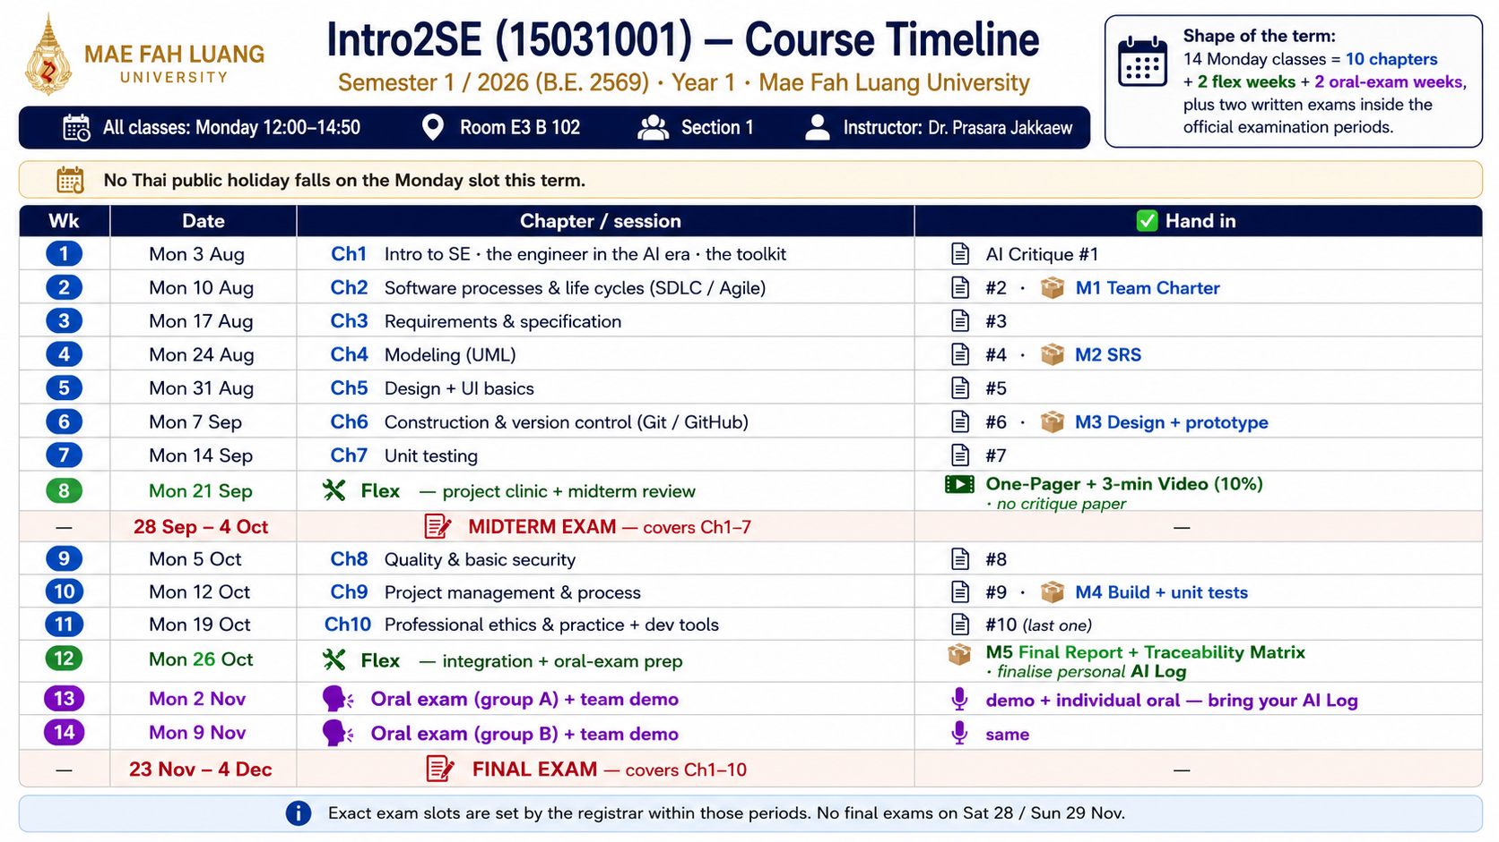
▶
intro-to-se · week 01
Page · The term
09 / 32
Notes:
How the fourteen weeks run

Slide 10

▶
intro-to-se · week 01
Page · Grading
10 / 32
ASSESSMENT · TOTAL 100%
How you'll be graded
COMPONENT
IND
TEAM
EXAM
AI
Group Project
30% · team-based, 5 milestones
Midterm Exam
20% · individual written exam
Final Exam
20% · individual written exam
One-Pager + Video
10% · article summary + 3-min video
Oral Exam
10% · Reflect on your Contribution
Attendance
10% · AI Critique sheet, on time
Notes:
Six components, one grade. Every component ties to a real engineering skill — not just exam performance.
30% Five milestones from problem definition to final demonstration. Teamwork, iteration, and delivery all count.
Midterm 20% and Final Exam 20%. Tests concepts, analysis, and application of software engineering principles.
One-Pager + 3-min Video 10%; Self-report + AI usage log 10%. Reflect on your process and AI tool use honestly.
Attendance and on-time submission. Consistency and professionalism are engineering habits, not formalities.

Slide 11
▶
intro-to-se · week 01
Page · Grades
11 / 32
GRADING
A – F
How marks become a grade
One hundred marks, no curve
The six components add up to 100. The bands on the right are applied directly — there is no curve, no bonus, and no negotiating at the boundary.
A
top
80 – 100
B+ / B
good
Seventy per cent is yours alone
75–79 / 70–74
Only the team project is a group mark. Everything else is earned individually, so your grade reflects the work you personally did.
C+ / C
fair
65–69 / 60–64
D+ / D
pass
55–59 / 50–54
Every rubric is published first
The criteria for each piece of work are in the handbook before that work is due. You can always see exactly how a mark was arrived at.
F
fail
below 50

Slide 12
▶
intro-to-se · week 01
Page · Your project
12 / 32
YOUR PROJECT
30%
One team project, four checkpoints
Teams of about five. Everyone works in the same problem space — helping a student organise their study life — but every team picks different features. Same domain, different solutions, so nobody can copy.
STAGE 01
STAGE 02
STAGE 03
STAGE 04
Charter & SRS
Model & design
Build & test
Demo & defend
Name the pain you actually care about and who has it, then write the requirements as user stories with acceptance criteria. Weeks 2–4.
Turn requirements into a use-case model and a simple architecture, and record one design decision together with the alternatives you rejected. Weeks 4–6.
A GitHub repository every member commits to, unit tests that check your own acceptance criteria, and a basic quality and security pass. Weeks 6–10.
A working demo, a final report, and an individual oral exam in which you explain the part you personally built. Weeks 13–14.

Slide 13
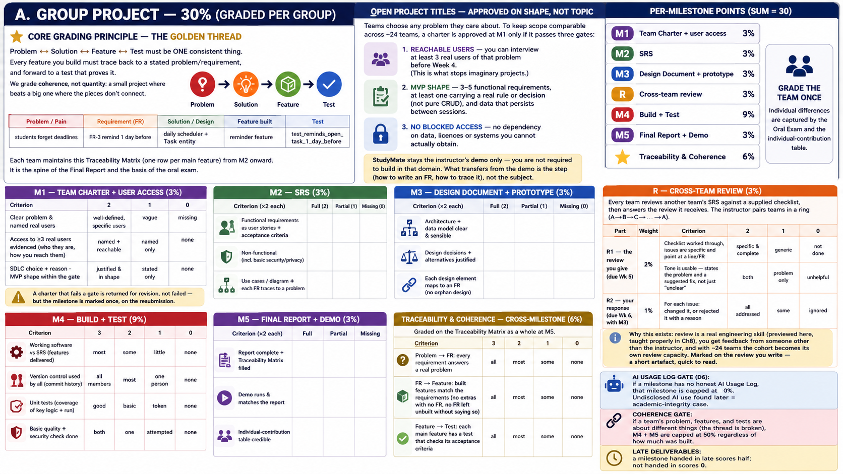
▶
intro-to-se · week 01
Page · Your project
13 / 32
30%

Slide 14


▶
intro2se-week01.fig
The rules · Assignment
14 / 32
INDIVIDUAL · 10%
DUE MON 21 SEP · WEEK 8
The article assignment, step by step
STEP 01
STEP 02
STEP 03
STEP 04
STEP 05
Pick an article
Make a one-pager
Record 3 minutes
Upload and link it
Submit as PDF
One article that genuinely interests you — from GitHub Resources (AI, dev, security, DevOps) or the Hugging Face blog / Daily Papers.
One page, A4 or 16:9: what the idea is, why it matters, how it works. Mind map, infographic or bullets — make it readable.
Present your own one-pager on camera, in your own words — like explaining it to a friend. Zoom, Meet, Canva or OBS all work.
Put the video on YouTube (Unlisted) or Google Drive (anyone with the link), then paste that link inside the one-pager.
Export the one-pager as .pdf with the link inside and upload it. Check the link opens from another account first.
your choice
1 page
3 min max
unlisted ok
Mon 21 Sep

Slide 15
▶
intro2se-week01.fig
The rules · Assignment marks
15 / 32
How the 10 marks are given
Four criteria. Two are about understanding the article, two are about communicating it — because in this course both are the point.
INDIVIDUAL · 10%
CONTENT
ONE-PAGER
COMMUNICATION
VIDEO QUALITY
3marks
3marks
2marks
2
grasp of the idea
design & clarity
within 3 min
audio & clarity
Main points captured correctly and faithfully to the article, not over-complicated, and explained so that a general audience understands.
Fits one page, concise and well organised, and the layout genuinely helps the reader understand rather than only decorating.
Engaging delivery in a clear logical order, presented with confidence — and finishing within the three-minute limit.
Speech clear and loud enough with little background noise, and both you and the one-pager clearly visible on screen.

Slide 16
▶
intro-to-se · week 01
Page · Attendance
16 / 32
How attendance works
No roll call. Your score comes from the “AI Critique” answer sheet you hand in at the end of every class.
INDIVIDUAL · 10%
ROLL CALL
EVERY CLASS
BRING IT
THE TASK
0
10 min
A4
3 steps
silent
last 10 min
+ a pen
on paper
There is no verbal roll call in this class — not now, not ever.
Submit a short answer sheet in the final 10 minutes of every class.
Bring your own A4 paper — or a notebook — and a pen to every lecture.
Spot the AI's deliberate error, explain why it's wrong, and give the correct fix.

Slide 17
▶
intro-to-se · week 01
The rules · AI Critique
17 / 32
EVERY CHAPTER CLASS
The last 10 minutes: find the AI's mistake
Each chapter class ends with a ten-minute exercise. I project something an AI wrote that contains a deliberate mistake. You answer in three steps, by hand, on A4 — and hand it in before you leave.
STEP 01
STEP 02
STEP 03
Spot the error
Explain why
Fix it
Point at exactly what the AI got wrong. Not "it looks off" — name the line, the arrow, or the claim that is incorrect.
One or two sentences on why it is wrong. This is the part AI cannot do for you, because it is the part that made the mistake.
Write the corrected version, or draw the correct diagram. Your paper is also your attendance for the day — there is no roll call.

Slide 18


▶
intro-to-se · week 01
Design-system-governance
18 / 32
AI USAGE POLICY
AI is allowed — humans stay accountable
STEP 01
STEP 02
STEP 03
STEP 04
STEP 05
Disclose Tool
State Purpose
Document Output
Verify Results
Submit Evidence
Name the AI tool you used (e.g. ChatGPT, Copilot, Gemini). Be specific and honest.
Record your prompt and explain why you used AI for that task.
Note what the AI produced. Mark what you accepted as-is and what you changed or rejected.
You check correctness, accuracy, and safety. AI can be wrong. Human judgment is final.
Attach your AI log with each deliverable. No log = unacknowledged AI use.
Required
In AI Log
Every use
Critical
With work

Slide 19
▶
intro-to-se · week 01
The rules · AI policy
19 / 32
THE AI POLICY
Use AI. Log it. Be able to explain it.
Do
Don't
Ask AI to explain what you don't understand
Submit work you cannot explain
Use it to learn faster — explanations, worked examples, alternative approaches. Understanding is the goal; the tool is only a shortcut to it.
In the oral exam you explain the part you built. If you cannot, that part scores zero — whoever, or whatever, wrote it.
Let it draft, then read, test and fix
Pass off a teammate's work as your own
Generated code is a first draft. Read every line you keep, run it against your tests, and correct what is wrong before you commit it.
Every member is questioned individually about their own contribution. Free-riding tends to surface in about thirty seconds.
Log every use, honestly
Hide that AI was involved
Keep an AI Usage Log: what you asked, what it produced, what you changed. Honest logging is never penalised here. Hiding it is.
Undisclosed AI use is an academic-integrity case. Disclosed AI use is simply how modern engineering works.

Slide 20
▶
intro-to-se · week 01
Applied Digital Technology
Week 1 · Monday 3 August 2026
15031001 · SEMESTER 1 / 2026
MAE FAH LUANG UNIVERSITY · SOFTWARE ENGINEERING
CHAPTER 1
Introduction to Software Engineering

Slide 21
▶
intro-to-se · week 01
Chapter 1 · What SE is
21 / 32
More than code
A program is code that runs. Software is the program plus everything that makes it usable and changeable — documentation, configuration, tests, data. A software product is engineered so that other people can use it, trust it, and change it years later.
A PROGRAM
A SOFTWARE PRODUCT
Runs on your machine
Runs for people you never meet
You wrote it, you understand it, you are the only user. If it breaks you remember why. A script that renames your files is a program — and that is programming.
Strangers depend on it, teammates who did not write it must change it, and it has to survive years of new requirements. Producing that is software engineering.
process
→
team
→
over years
→
a product

Slide 22

▶
intro-to-se · week 01
Page · What is SE
22 / 32
CORE LECTURE · WHAT & WHY
What is software engineering?
Software engineering is the disciplined practice of building software that a team can maintain, that behaves safely under real conditions, and that keeps serving users long after release. Code that merely compiles is not the same as software that is safe and reliable.
LIFETIME COST · MAINTENANCE
60%+
of a software system's total cost is spent after launch — on maintenance, fixes, and change. Planning for that life is engineering.

Slide 23
▶
intro-to-se · week 01
Page · The Definition
23 / 32
CORE LECTURE · THE DEFINITION
What the textbook actually says
“The application of a systematic, disciplined, quantifiable approach to the development, operation, and maintenance of software.” — IEEE Std 610.12
KEYWORD 01
KEYWORD 02
KEYWORD 03
Systematic
Disciplined
Quantifiable
A repeatable process, not ad-hoc improvisation. Steps, models, and structure guide the work from start to finish.
Proven practices applied consistently — reviews, testing, documentation — even when shortcuts feel faster.
Quality, effort, and progress are measured. What you can measure, you can manage, improve, and defend with evidence.

Slide 24
▶
intro-to-se · week 01
Page · Programming vs Engineering
24 / 32
Programming vs. Software Engineering
One is a task. The other is a discipline. The difference is scale, teamwork, and what happens when it breaks.
APPROACH 01
APPROACH 02
Programming — the doghouse
Engineering — the skyscraper
One person, a few materials, little planning. If it breaks, you build another. Small scope, low stakes.
A team, blueprints, structural math, and years of planned maintenance. Failure is costly and affects real lives and businesses.
team
·
plan
·
scale
·
maintain

Slide 25
▶
intro2se-week01.fig
Chapter 1 · Types
25 / 32
TYPES OF SOFTWARE
Different types, different requirements
First split: generic products are built for an open market and the vendor imagines the requirements (Excel, LINE); custom or bespoke software is built for one customer who states their need (a hospital's queue system). Then the platform changes the constraints again — which is why Chapter 3 is about capturing requirements before building.
TYPE 01
TYPE 02
TYPE 03
TYPE 04
Web
Mobile
Embedded
Data & AI
Runs in a browser, updates for everyone at once. Constraints: connectivity, many browsers, and load at peak times.
Lives on a personal device. Constraints: battery, small screen, offline use, and app-store review before every release.
Inside a car, a rice cooker, a medical device. Constraints: tiny memory, real-time response, and safety — you cannot patch it easily.
Behaviour comes partly from data, not only code. Constraints: data quality, and outputs that are hard to test because they are not always the same.

Slide 26
▶
intro2se-week01.fig
Chapter 1 · Quality
26 / 32
CHAPTER 01
QUALITY ATTRIBUTES
“It runs” proves almost nothing
A demo is not evidence
Working once, on your laptop, with data you chose, tells you very little about whether the software is any good. Quality is a set of attributes you have to check deliberately.
Reliable
Ch7
keeps working
Usable
Ch5
Five to remember this term
real users can use it
The list on the right is the short version we will use. The international standard ISO/IEC 25010 defines the full catalogue if you want the complete picture.
Maintainable
Ch6
the next dev can change it
Secure
Ch8
protects users and data
Where each one returns
Security and quality get their own chapter (Ch8), testing checks reliability (Ch7), and maintainability is why we care about readable code and version control (Ch6).
Fast
Ch8
acceptable speed and cost

Slide 27
▶
intro-to-se · week 01
Chapter 1 · The process
27 / 32
CHAPTER 01
THE SOFTWARE PROCESS
Five activities, repeated until it ships
STEP 01
STEP 02
STEP 03
STEP 04
STEP 05
Specify
Design
Build
Validate
Evolve
Decide what to build and write it down so it can be checked. Most failed projects fail here, not in the code.
Decide how to build it: the parts, how they connect, and which trade-off you chose and why.
Write the code. AI-assisted is fine — as long as you can read it, test it and explain it.
Test that it does what the specification promised. A feature with no test is only a rumour.
Real software keeps changing. Maintenance is not the clean-up afterwards — it is most of the life of the system.
the what
the how
with Git
unit tests
all term

Slide 28
▶
intro-to-se · week 01
Chapter 1 · Ethics
28/ 32
PROFESSIONAL ETHICS · INTRO
Responsibility beyond “it works”
Engineers have duties that no specification lists. The ACM and IEEE Computer Society publish a Software Engineering Code of Ethics; its first principle puts the public interest ahead of the client, the employer, and you. We come back to this properly in Chapter 10.
DUTY 01
DUTY 02
DUTY 03
Public interest first
Honesty about ability
Care with user data
If what you are building could harm the people who use it — lost data, leaked information, unsafe behaviour — you have to raise it, even when raising it slows the project down.
Do not claim skills you do not have, and do not hide what you do not understand. In this course that includes being honest about which parts AI wrote for you.
Confidentiality, respect for intellectual property, and collecting only the data you actually need. Your project handles student schedules — that is personal data.

Slide 29
▶
intro-to-se · week 01
Week 1 · Developer Role in AI Era
29/ 32
03 · THE HUMAN ENGINEER IN THE AI ERA
Developer Role in the AI Era
AI tools accelerate coding — but the engineer's role has expanded, not disappeared. The shift is from writing code to owning outcomes.
ROLE 01
ROLE 02
ROLE 03
ROLE 04
Coder
Reviewer
System Orchestrator
Risk Owner
AI tools assist here. GitHub Copilot, Cursor, Claude Code, and Gemini API generate boilerplate, suggest completions, and speed up implementation.
You read, question, and validate AI output. Does it meet requirements? Is it secure? Does it handle edge cases? Human judgment cannot be delegated.
Define problems clearly. Integrate AI-generated components. Validate the whole system. Manage dependencies, data flow, and architectural decisions.
When AI-generated code fails in production, the engineer is accountable. Identify risks, document decisions, and ensure safety before shipping.
Notes:
9

Slide 30
▶
intro-to-se · week 01
Pillars · Overview
30 / 32
14 · HUMAN VALUE
What only the engineer can own
AI proposes — the engineer judges. Three irreplaceable human competencies that no model can replace in professional software development.
PILLAR 01
PILLAR 02
PILLAR 03
Empathy & UX
Requirements Analysis
Architectural Decisions
Understanding real user pain, context, and emotion. Engineers translate human needs into design decisions that AI cannot feel or infer from prompts alone.
Eliciting, clarifying, and prioritizing what stakeholders truly need — not just what they say. Ambiguity resolution requires human judgment and domain knowledge.
Choosing trade-offs across scalability, security, and maintainability for the long term. AI proposes options — the engineer owns the consequences and accountability.
Notes:
5

Slide 31

▶
intro-to-se · week 01
Week 1 · Exit Ticket
31 / 32
SLIDE 16
AI CRITIQUE EXIT TICKET
Read, Critique & Fix
Scenario
"To start a large software project, coding speed is the only thing that matters. If you use AI to write code fast, you do not need to plan architecture, talk to users, or document requirements. Just let AI generate the code and the software will succeed."
Spot the Error
Identify the false assumption
Task 1
Explain Why
Task 2
doghouse vs. skyscraper analogy
Your Three Tasks
Fix It
Task 3
① Spot the error — What is the false claim in the scenario above?
② Explain why — Use the doghouse vs. skyscraper analogy or explain why AI alone cannot replace planning.
③ Fix it — Name at least two things engineers must prioritize before writing any code.
priorities before coding begins
References
O'Reilly 2023
Sommerville 2015 · IEEE Std 610.12-1990
Due
Name + ID
Submit Before Leaving
End of class · today
Write on A4 or notebook paper. Include your Full Name and Student ID. Hand in to the instructor before you exit the room.
Notes:
6

Slide 32
▶
intro-to-se · week 01
Now
32/ 32
BEFORE YOU LEAVE
Form your team and name a real problem
Bring next week
A4 paper + a pen
Read before Ch2
Sommerville chapter 1
Get into groups of about five. Each person names one thing about student life that genuinely frustrates them — not a nice idea, a real irritation. Pick the one your team cares about most and write it as a single sentence: who has the problem, and why it matters. That sentence becomes your Team Charter, due next week.
Create an account
github.com
Next week
Ch2 · Software processes

